Slide 1
Acts 4:1-22

Slide 2
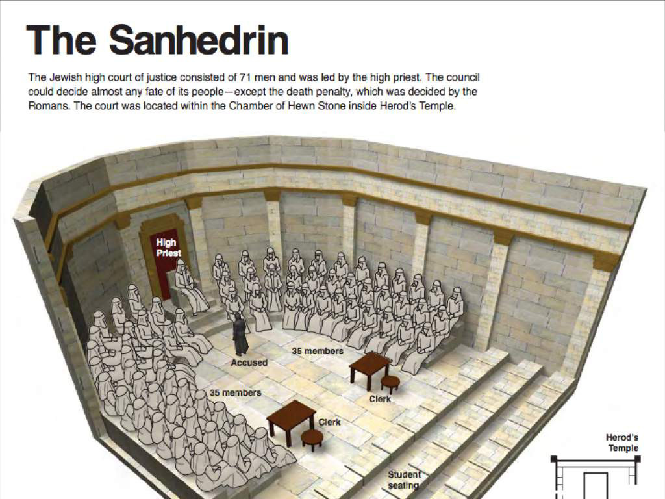
Read Acts 4:1-4
“Priests” - some of the Jewish religious leaders
“Temple Guard” - the temple police
“Sadducees” - a Jewish group who were some of the religious leaders.

Slide 3
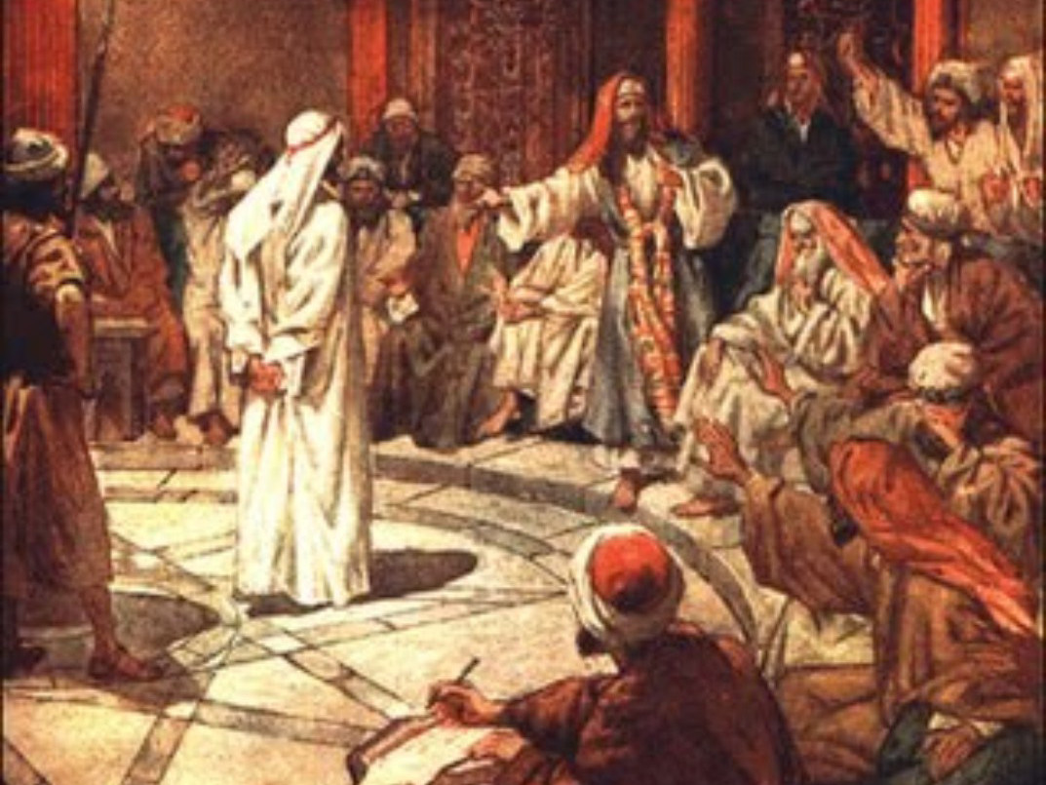
Read Acts 4:1-4
How do the Jewish leaders feel about the apostles’ teaching? Why?
So what do they do?

Slide 4
Read Acts 4:1-4
How did the Jewish leaders feel about the apostles’ teaching? Why?
Greatly disturbed - Annoyed
The apostles were teaching the people that Jesus rose from the dead.
At the time, some leaders believe in the resurrection, but they only think it will happen at God’s final judgement.
They don’t think Jesus rose from the dead.
So what do they do?
They put Peter and John in jail
BUT
Many heard and believed

Slide 5
Read Acts 4:5-12
“High Priest” - the most important of the Jewish religious leaders.
“Salvation” - rescue from God’s anger at sin

Slide 6
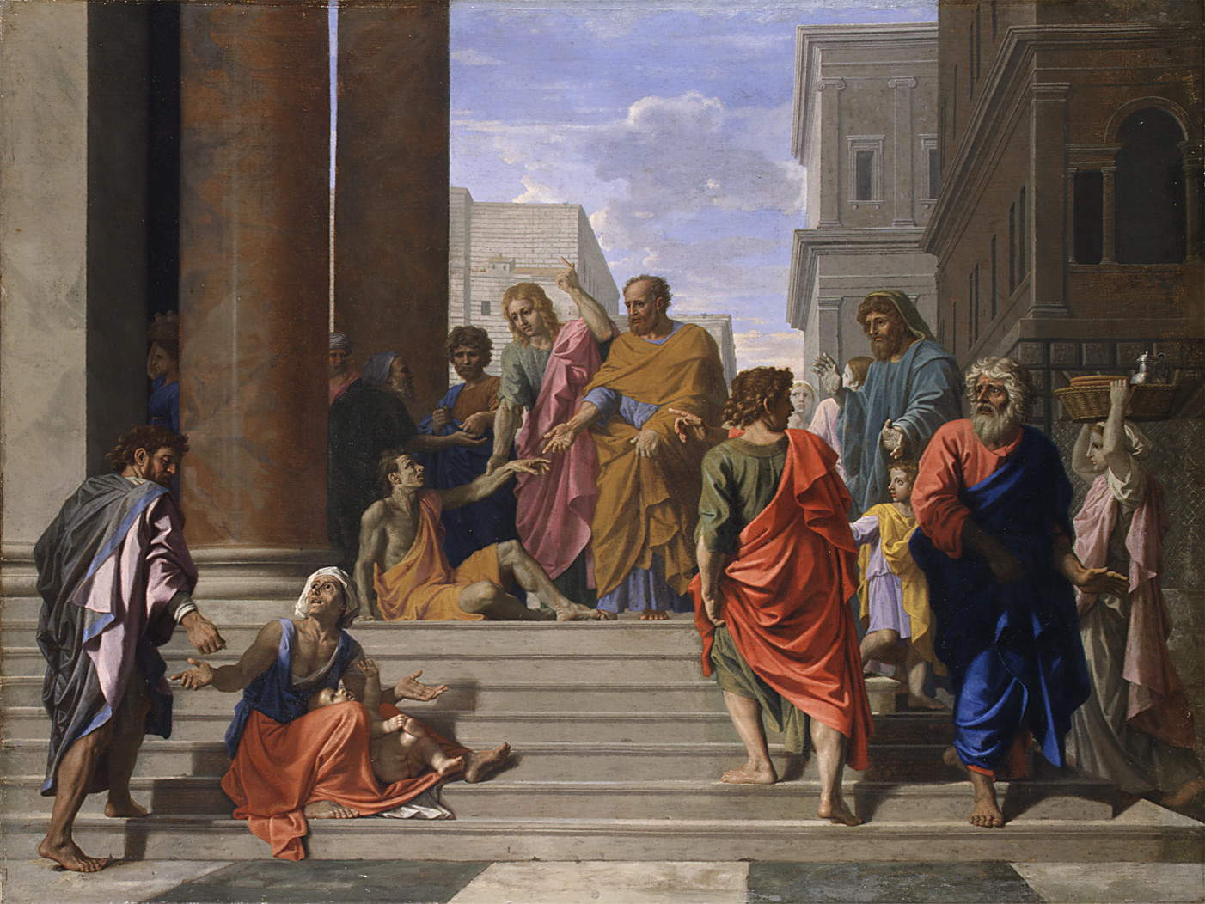
Read Acts 4:5-12
Who is at the meeting in verses 5-6? Why do you think Luke tells us about all these people?
How does Peter answer their question in verse 7? (See v8-12)
What does Peter say about salvation in verse 12?

Slide 7
Read Acts 4:5-12
Who is at the meeting in verses 5-6? Why do you think Luke tells us about all these people?
All of the important religious leaders meet together
Peter and John could easily be afraid
But Peter is filled with the Holy Spirit
Jesus promised the Holy Spirit would do this (Luke 12:11-12)
Luke 12:11-12
“When you are brought before synagogues, rulers and authorities, do not worry about how you will defend yourselves or what you will say, 12 for the Holy Spirit will teach you at that time what you should say.”

Slide 8
Read Acts 4:5-12
How does Peter answer their question in verse 7? (See v8-12)
Peter repeats what he said in chapter 3. The man was healed by Jesus. The leaders killed Jesus, but God raised him from the dead.

Slide 9
Read Acts 4:5-12
What does Peter say about salvation in verse 12?
Peter quotes Psalm 118:22
It uses the picture of a stone that is thrown away
That stone is then put in the most important place: the cornerstone.
The person who was rejected is now put in the highest place.
That’s what happened to Jesus

Slide 10
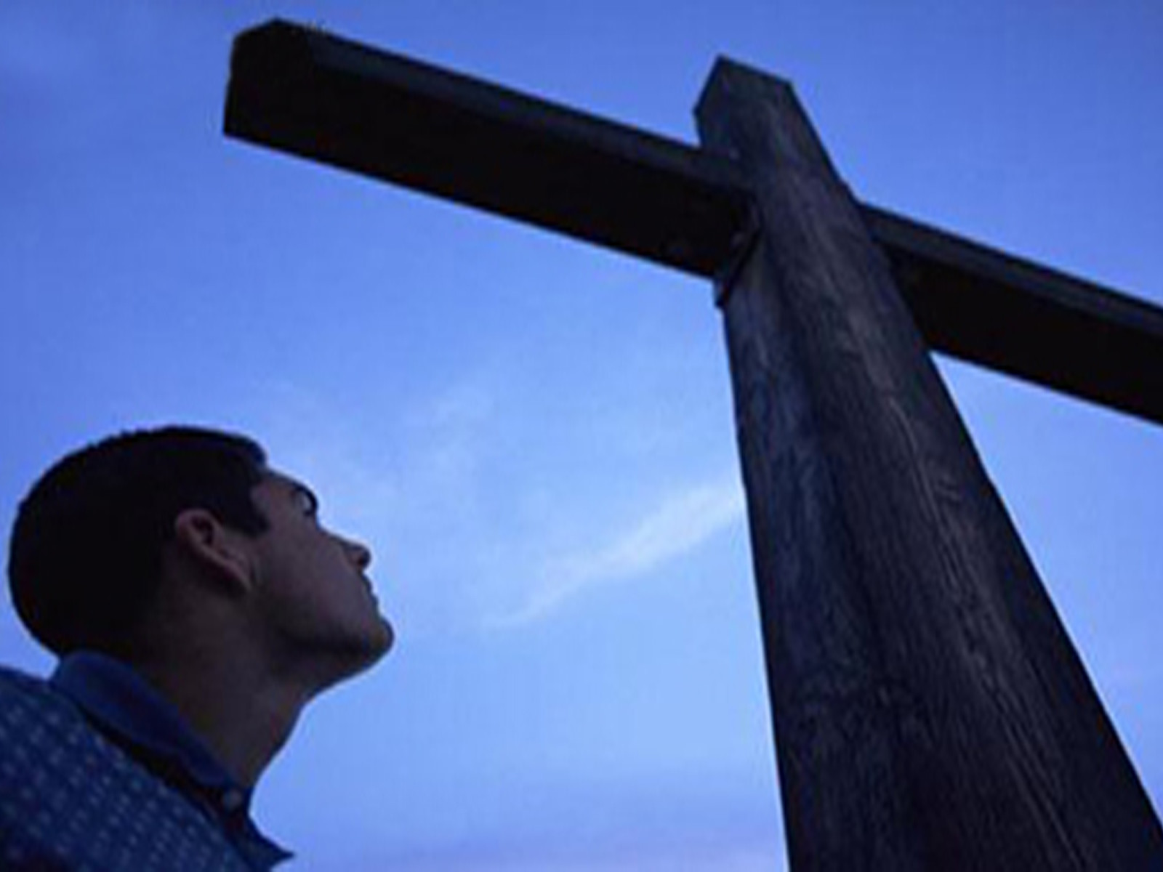
Jesus is the only way
to be saved

Slide 11
Read Acts 4:13-22
“Unschooled” - not trained in religion.
“Sanhedrin” - the ruling group of religious leaders

Slide 12
Read Acts 4:13-22
How do the Jewish leaders respond to Peter and John?
What do they decide to do?
How does Peter answer?

Slide 13
Read Acts 4:13-22
How do the Jewish leaders respond to Peter and John?
The leaders were astonished at the courage of Peter and John
They could not deny that the man was healed
They discussed the problem together

Slide 14
Read Acts 4:13-22
What did they decide to do?
They acknowledge that a miracle happened
But they did not want the message of Jesus’ resurrection to spread
So they commanded Peter and John not to speak in the name of Jesus

Slide 15
Read Acts 4:13-22
How does Peter answer?
Peter and John refuse.
They will listen to God, not to the leaders.
They must continue speaking about what they have seen and know about Jesus.
The leaders cannot do anything because everyone knows an amazing miracle happened

Slide 16
We must speak about him

Slide 17
The Big Idea

Slide 18
The Aim

